Slide 1
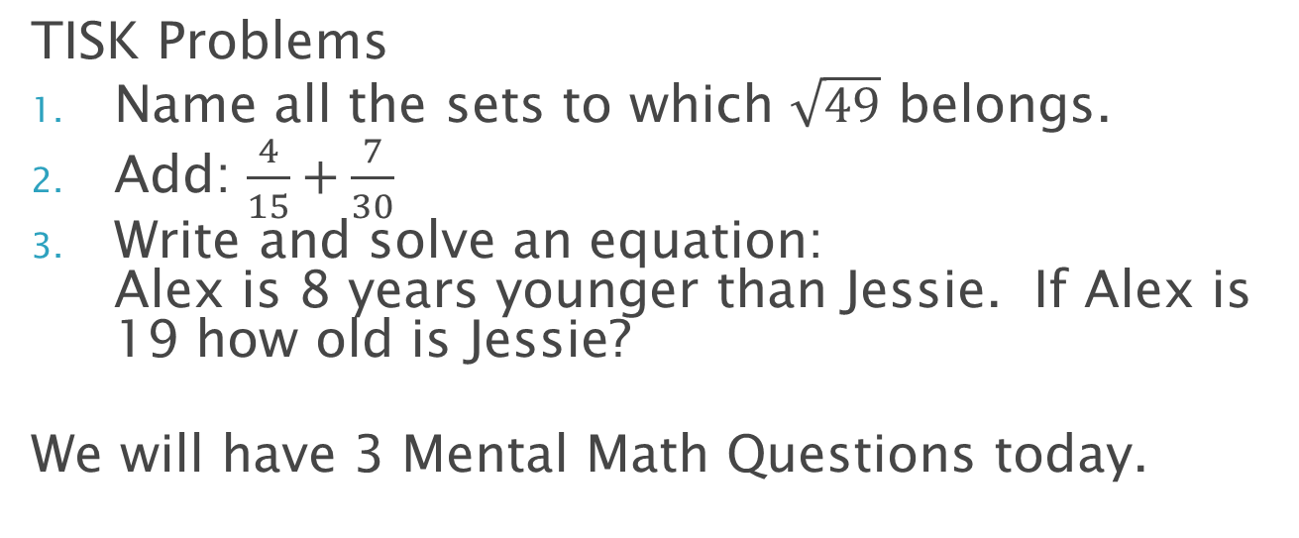
Wednesday, September 5, 2012
TISK Problems
Name all the sets to which $\sqrt{49}$ belongs.
Add: $\frac{4}{15}+\frac{7}{30}$
Write and solve an equation: Alex is 8 years younger than Jessie. If Alex is 19 how old is Jessie?
We will have 3 Mental Math Questions today.
Homework: p. 402-403 #9-22 &24
OPTIONAL: #1-8
Notes:
Mental Math
Start with the square of 6. Take half. Divide by 6. Square it. (9)
Start with the square of 12. Take half. Divide by 6. Square it. (144)
Start with the square of 9. Add one. Take half. Add one. Divide by 6. Square it. (49)

Slide 2
Pre-Algebra Book
We will be working in the pre-Algebra book now until the end of the semester.

Slide 3
8-1 Relating Decimals, Fractions, and Percents
What does percent mean?
Per-: for every
-cent: one hundred
Therefore, percent means “for every 100”
So 36% means…?
36 for every 100
36% of people prefer cats to dogs
36 out of every 100 people asked prefer cats to dogs

Slide 4
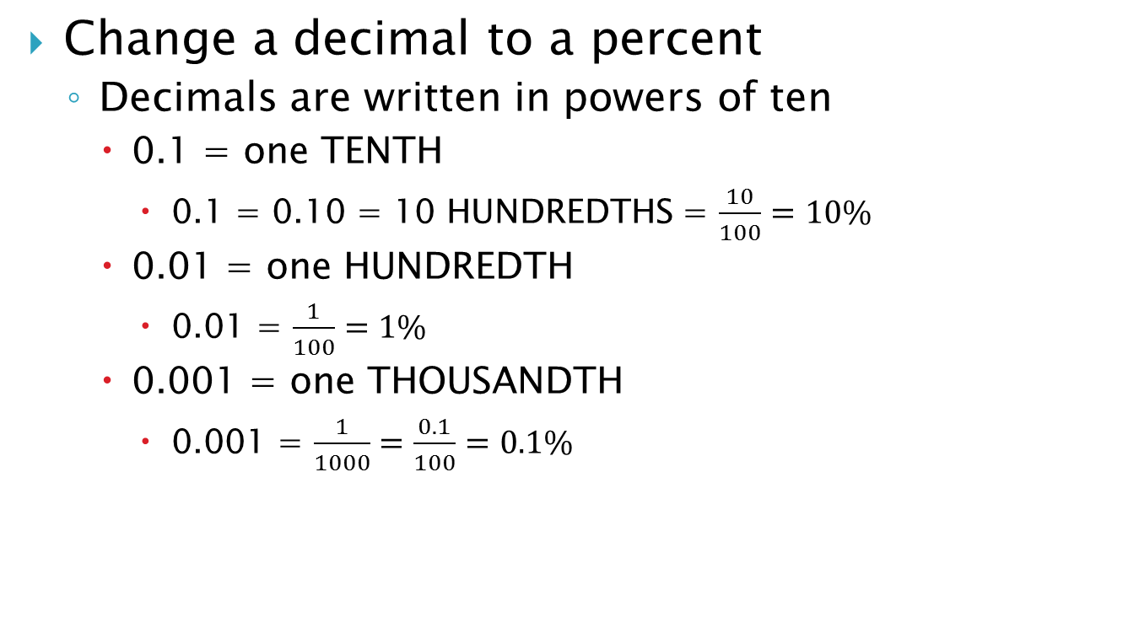
Converting to/from Percents
Change a decimal to a percent
Decimals are written in powers of ten
0.1 = one TENTH
0.1 = 0.10 = 10 HUNDREDTHS = $\frac{10}{100}=10\%$
0.01 = one HUNDREDTH
0.01 = $\frac{1}{100}=1\%$
0.001 = one THOUSANDTH
0.001 = $\frac{1}{1000}=\frac{0.1}{100}=0.1\%$

Slide 5
You try it
Convert each decimal to a percent.
0.45
45%
0.08
8%
0.602
60.2%
0.99
99%
0.875
87.5%
1.03
103%

Slide 6
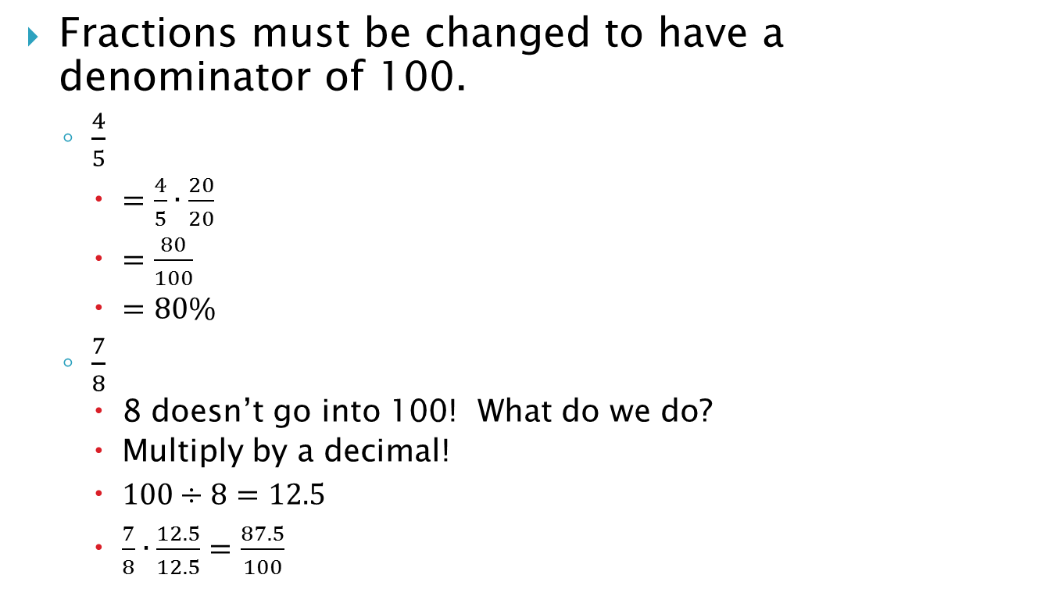
Converting to/from Percents
Fractions must be changed to have a denominator of 100.
$\frac{4}{5}$
$=\frac{4}{5}∙\frac{20}{20}$
$=\frac{80}{100}$
$=80\%$
$\frac{7}{8}$
8 doesn’t go into 100! What do we do?
Multiply by a decimal!
$100÷8=12.5$
$\frac{7}{8}∙\frac{12.5}{12.5}=\frac{87.5}{100}$

Slide 7
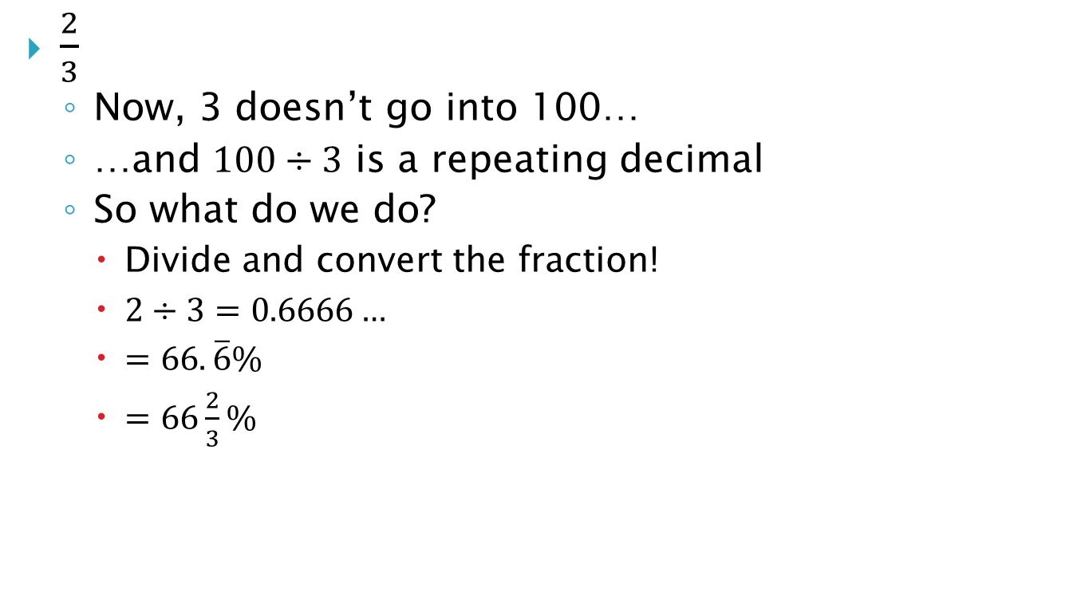
Converting to/from Percents
$\frac{2}{3}$
Now, 3 doesn’t go into 100…
…and $100÷3$ is a repeating decimal
So what do we do?
Divide and convert the fraction!
$2÷3=0.6666…$
$=66.\overline{6}\%$
$=66\frac{2}{3}\%$

Slide 8
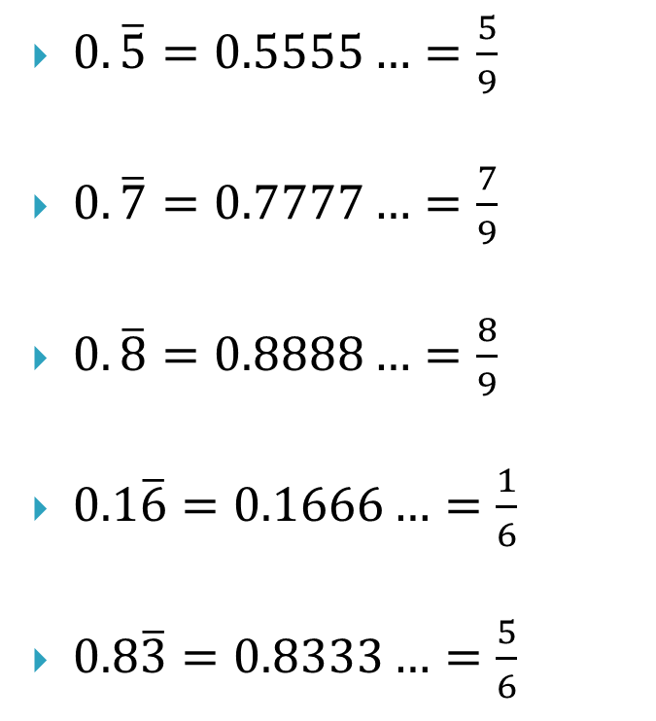
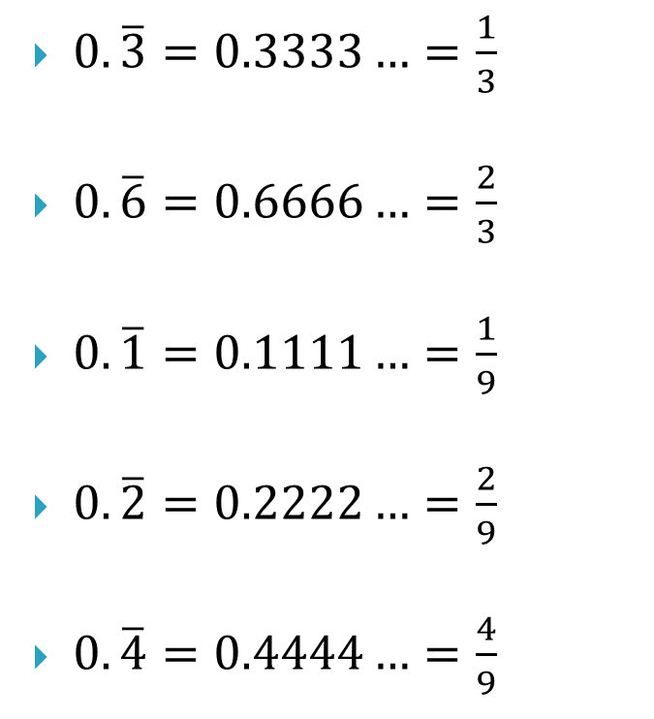
Some Common Repeating Decimals You Should Know!
$0.\overline{3}=0.3333…=\frac{1}{3}$
$0.\overline{6}=0.6666…=\frac{2}{3}$
$0.\overline{1}=0.1111…=\frac{1}{9}$
$0.\overline{2}=0.2222…=\frac{2}{9}$
$0.\overline{4}=0.4444…=\frac{4}{9}$
$0.\overline{5}=0.5555…=\frac{5}{9}$
$0.\overline{7}=0.7777…=\frac{7}{9}$
$0.\overline{8}=0.8888…=\frac{8}{9}$
$0.1\overline{6}=0.1666…=\frac{1}{6}$
$0.8\overline{3}=0.8333…=\frac{5}{6}$

Slide 9

You Try It
Convert each fraction to a percent.
$\frac{7}{25}$
28%
$\frac{4}{9}$
$44\frac{4}{9}\%$
$\frac{11}{40}$
27.5%
$\frac{2}{15}$
$13\frac{1}{3}\%$

Slide 10
Homework
Homework: p. 402-403 #9-22 &24
OPTIONAL: #1-8

